Slide 1
Data Analyst Nanodegree
Session 4
Conducted by: Hamza
Notes:
https://udacity.zoom.us/j/7991233356

Slide 2
SUPPORT / REPO
fwd-support@udacity.com
https://github.com/santarabantoosoo/Data-Analysis-NanoDegree

Slide 3
Agenda
When not to use statistics!
Project
Conditional probability and bayes rule
Real life exercise (encounter the normal distribution)
Bayesian project

Slide 4
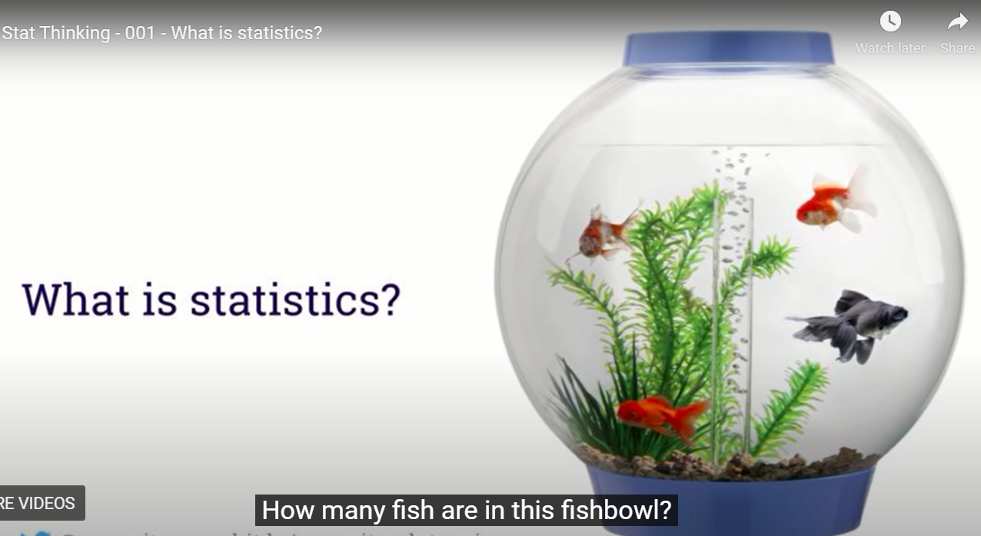
When not to use statistics?
Notes:
Let’s call them goldfish

Slide 5
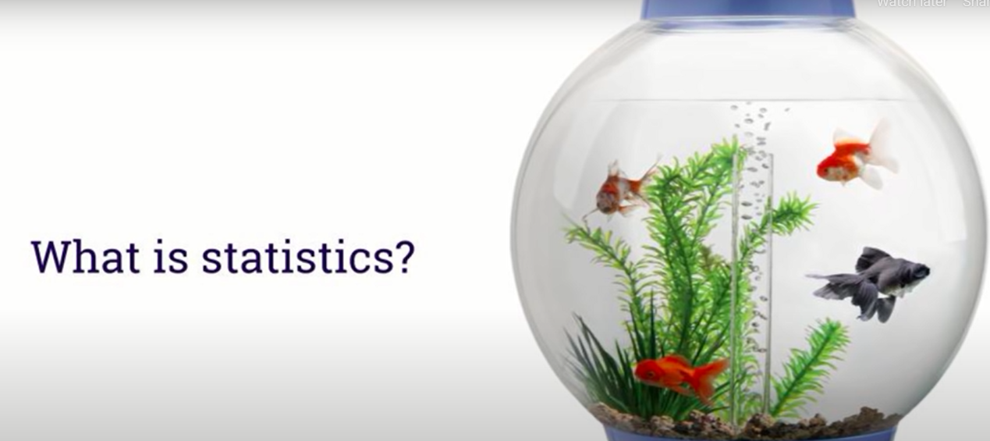
Different colors?
Notes:
Can gold fish in general have different colors?

Slide 6
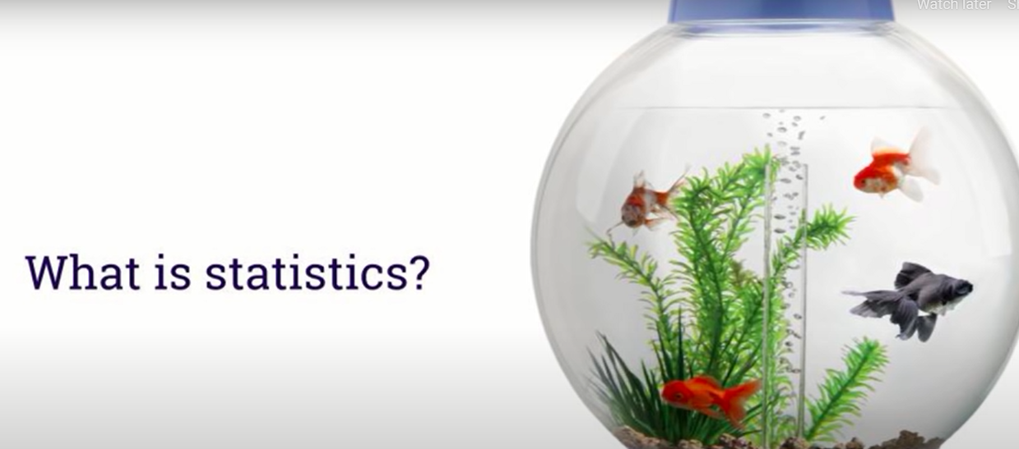
Gold .. Not gold?
Notes:
Can a gold fish have a non-gold color ? Yes

Slide 7
Are these questions about data?

Slide 8
Are these questions about data?
Yes
Are these questions about statistics?

Slide 9
Are these questions about data?
Yes
Are these questions about statistics?
No!

Slide 10
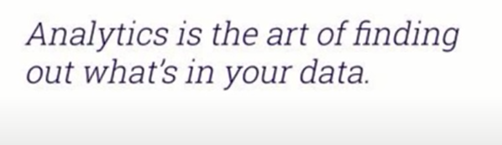
Going beyond the data?
Notes:
Sine we are describing our dataset, that’s data mining or analytics or descriptive statistics

Slide 11
Different colors?
Why not stats?
Notes:
Because u are certain about the answer

Slide 12
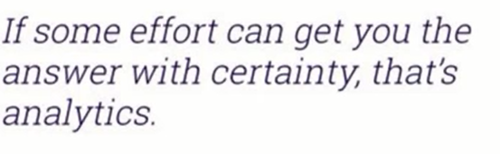
Different colors?

Slide 13
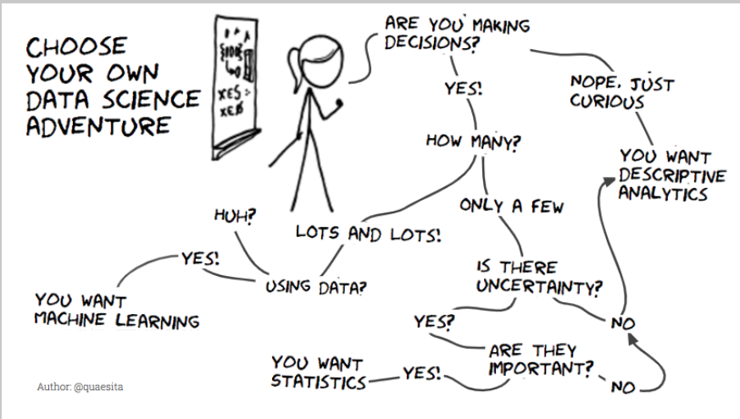
Notes:
Is there uncertainty?

Slide 14
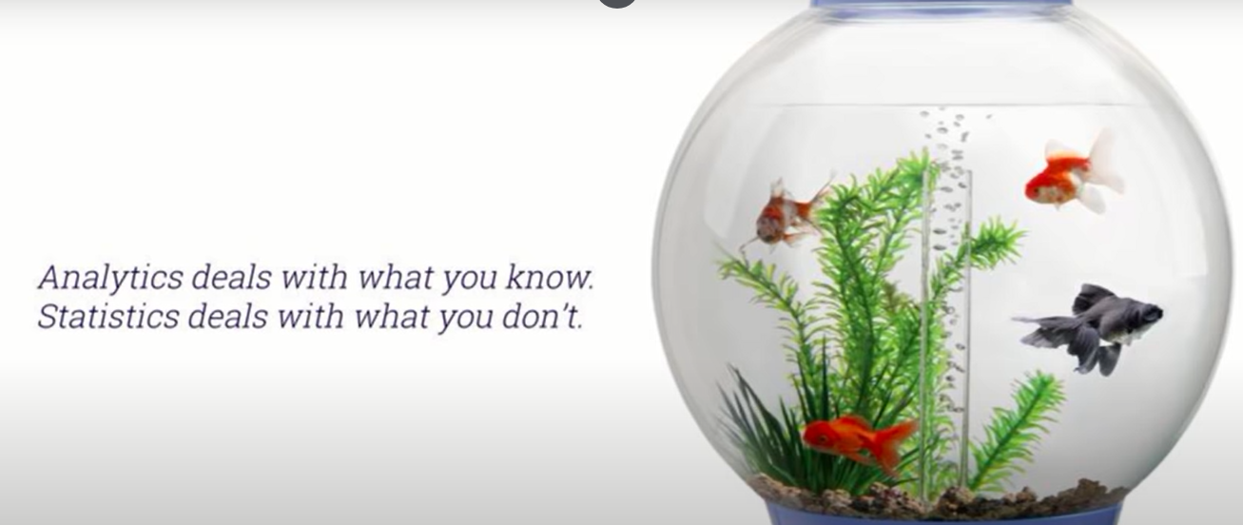
Statistics vs analytics

Slide 15
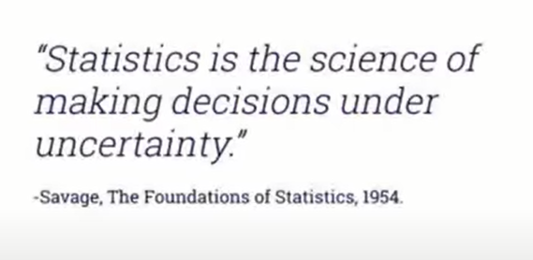
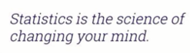
Statistics

Slide 16
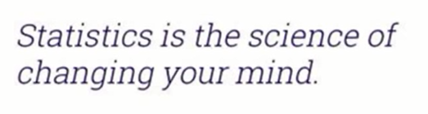
My mind?

Slide 17
My mind?
Prior belief
Default action

Slide 18
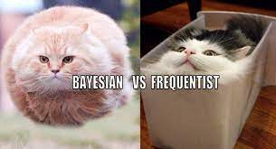
My mind?
Prior belief
Default action

Slide 19

PHD statistics
Notes:
U don’t want to have PhD in stats without knowing when to use statistics

Slide 20
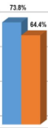
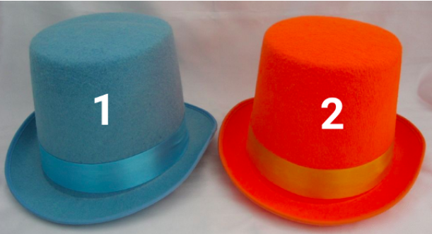
indifferent
Notes:
If you’re indifferent between these hats to begin with and you get more votes for blue than orange, there’s no math in the world that should tell you to pick orange. Math isn’t magic and it doesn’t violate common sense.

Slide 21
When to choose orange?
Notes:
The only way it makes sense to end up choosing blue is if you had a preference for the blue hat to begin with. Then you’re asking whether the evidence in favor of orange is strong enough. In other words, whether there’s enough data to change your mind. Okay, so how can you tell?

Slide 22
indifferent
Do I need statistics?
Notes:
No!!!
Don’t waste ur time

Slide 23
indifferent
What if I am wrong?
Notes:
“But it could be wrong!” Of course it could be wrong, that’s what it means to be uncertain. There’s no mathemagic in the world that can make certainty out of uncertainty. Your best guess might be a mistake, but it is your best guess, which makes any other guess a worse guess and even more likely to be wrong.

Slide 24
Welcome to uncertainty
What if I am wrong?
Notes:
“But it could be wrong!” Of course it could be wrong, that’s what it means to be uncertain. There’s no mathemagic in the world that can make certainty out of uncertainty. Your best guess might be a mistake, but it is your best guess, which makes any other guess a worse guess and even more likely to be wrong.

Slide 25
indifferent
0.001 difference?
Notes:
Msh far2a
This is ur best guess

Slide 26
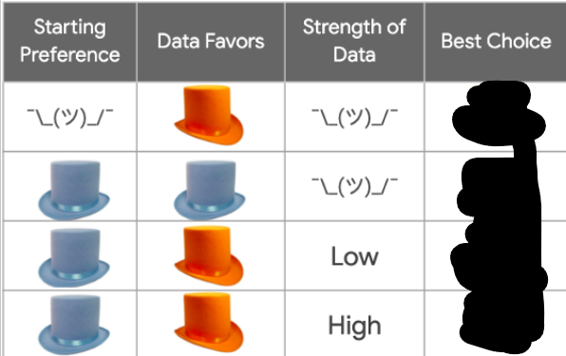
What to choose?

Slide 27
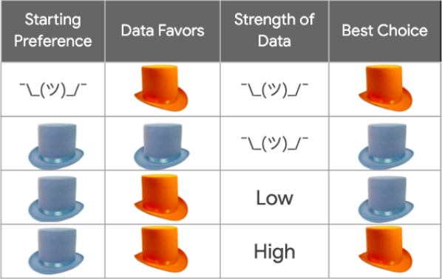

Slide 28
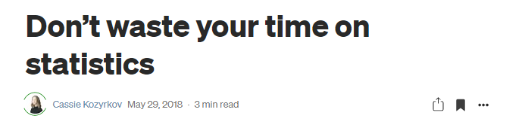
Notes:
Don’t waste your time on statistics | by Cassie Kozyrkov | Towards Data Science
https://towardsdatascience.com/whats-the-point-of-statistics-8163635da56c

Slide 29
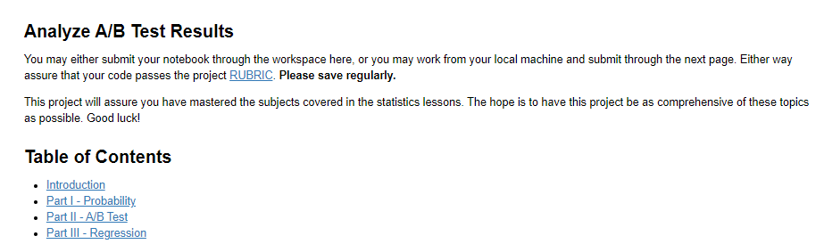
Project

Slide 30
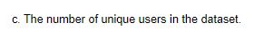
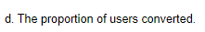
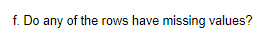

Slide 31
https://review.udacity.com/#!/rubrics/1214/view

Slide 32
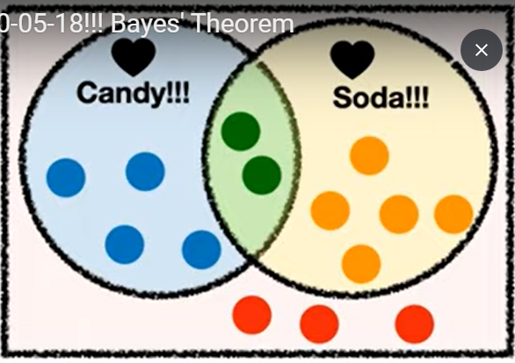
bayes

Slide 33
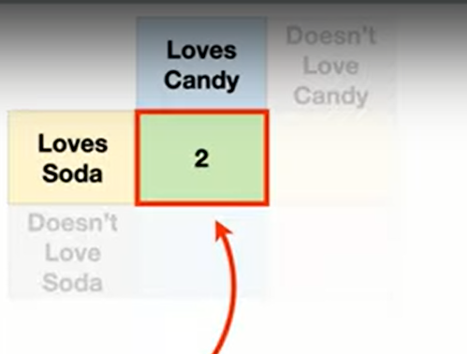

Slide 34
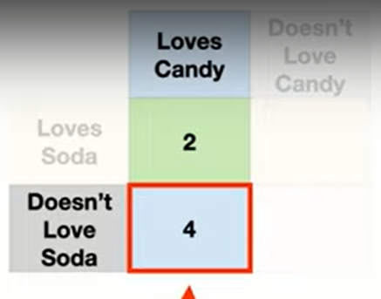

Slide 35
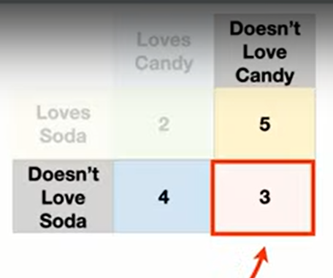

Slide 36
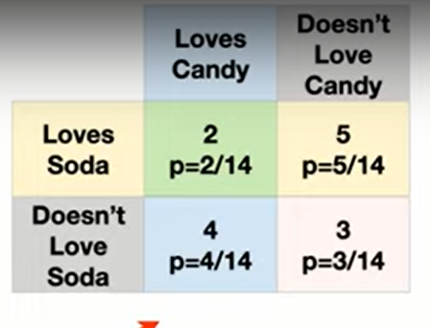

Slide 37
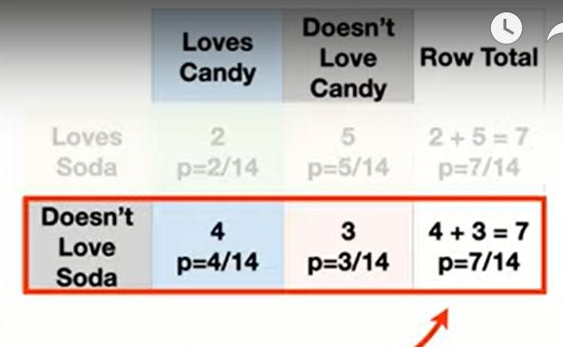

Slide 38
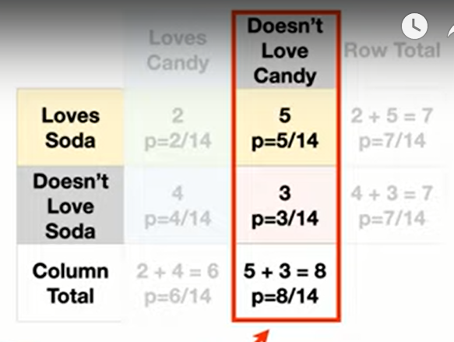

Slide 39
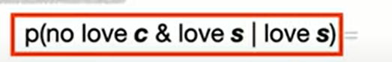
`

Slide 40
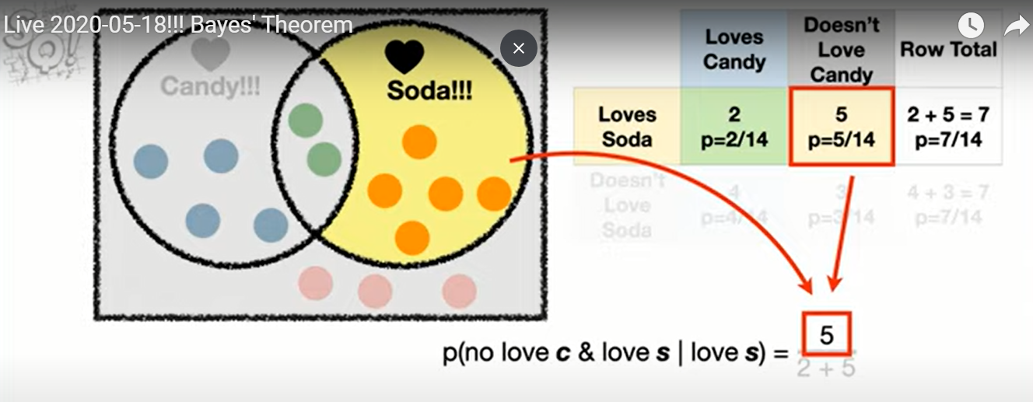

Slide 41
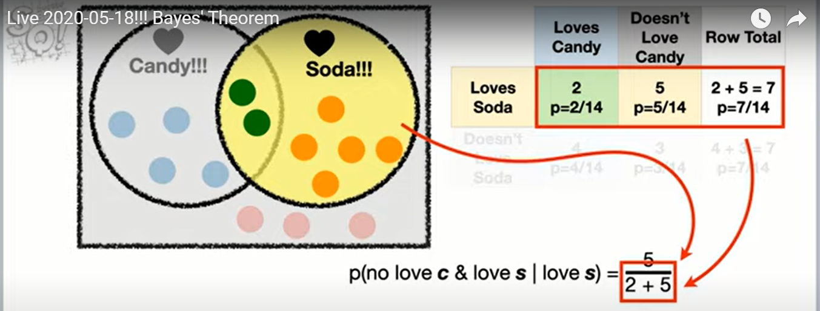

Slide 42
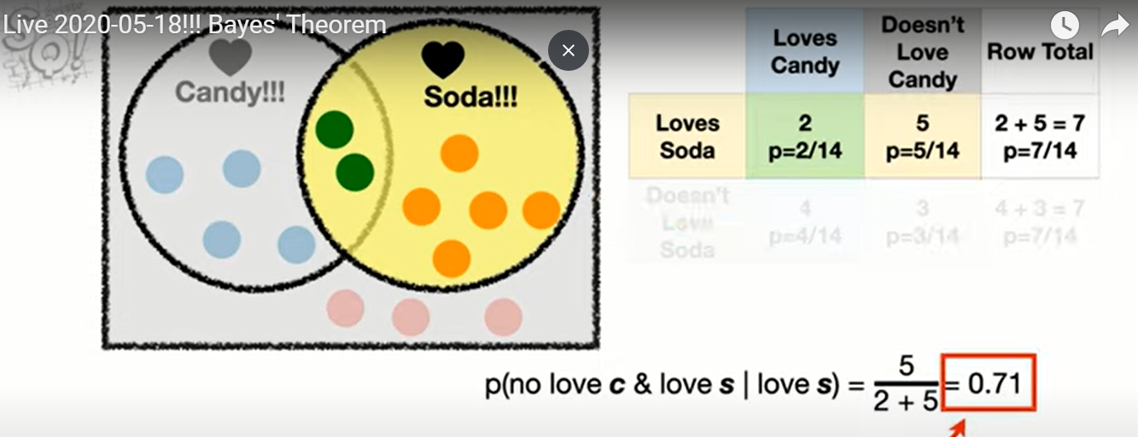

Slide 43
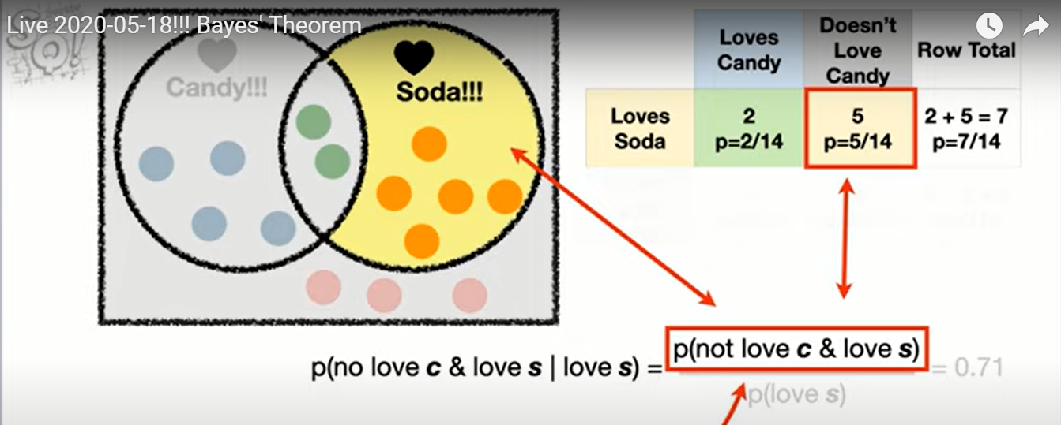

Slide 44
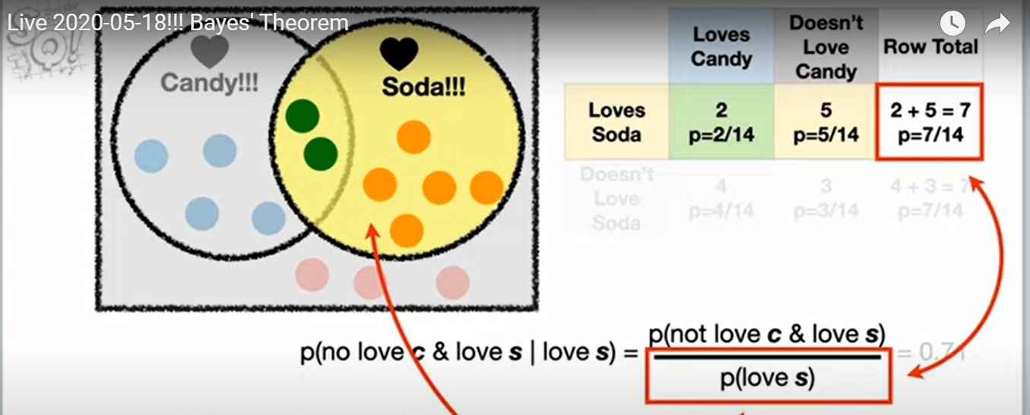

Slide 45
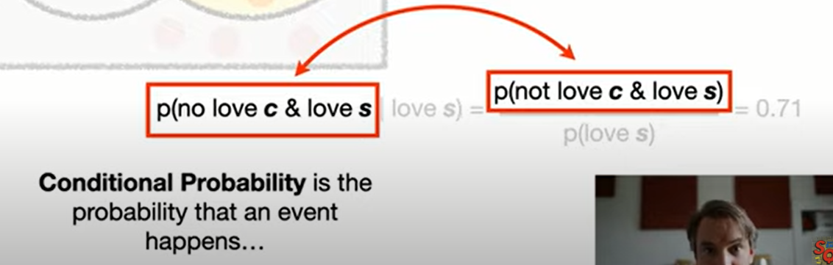

Slide 46
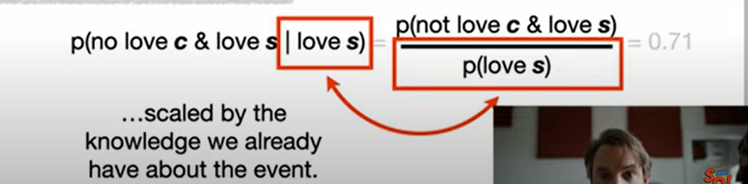

Slide 47
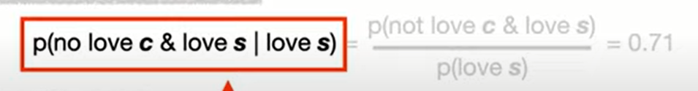
Any redundancy?

Slide 48
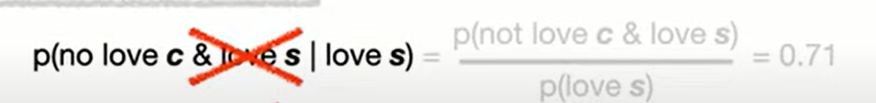
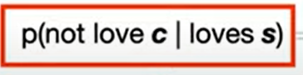
Any redundancy?

Slide 49
Love redundancy ☺
Any redundancy?

Slide 50
Try it yourself
P(love c | no love s)

Slide 51
solution
P(love c | no love s) = 4/7

Slide 52
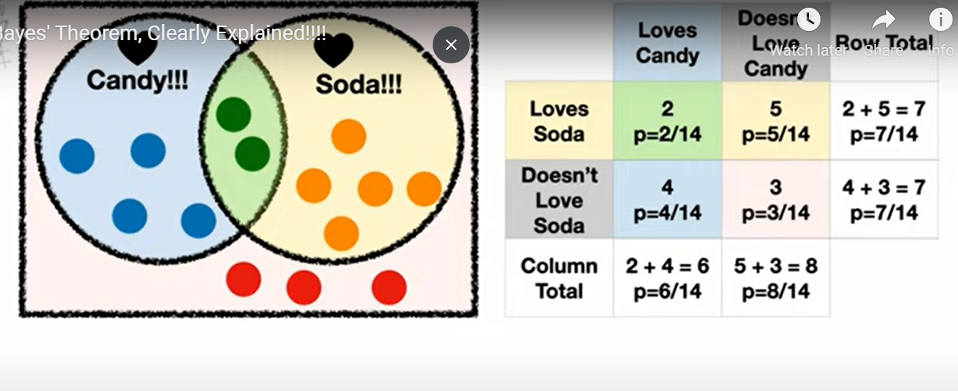
Notes:
Bayes theorem is not a big deal

Slide 53
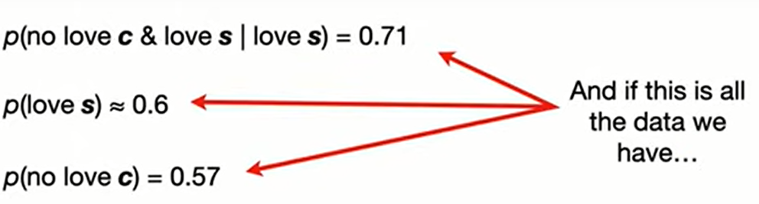

Slide 54
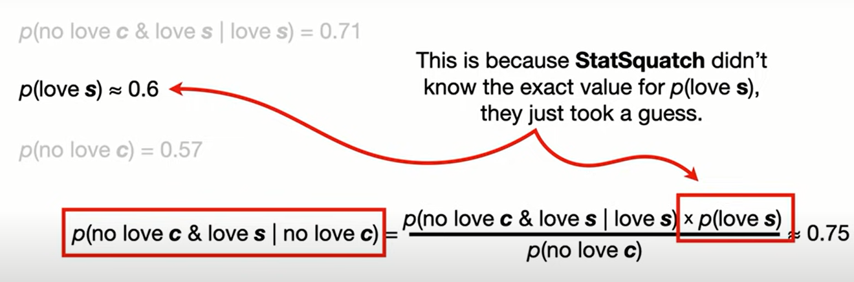

Slide 55
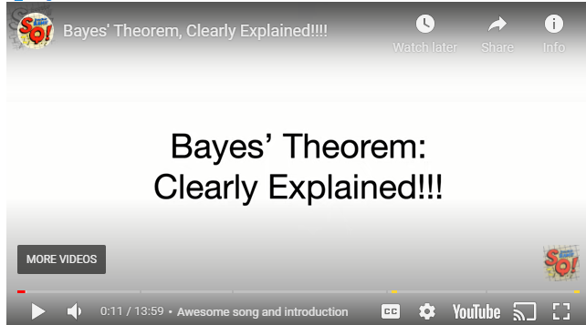
More info?
Notes:
https://statquest.org/bayes-theorem-clearly-explained/

Slide 56
Bayes exercise
A case study with Conditional probability | Kaggle
https://www.kaggle.com/lakshya91/a-case-study-with-conditional-probability
Check notebook
Check dataset
Explore kaggle

Slide 57
Alternative solution
Notebooks for udacity execises
But before this, can our life be easier with NB?
https://medium.com/@maxtingle/10-jupyter-notebook-extensions-making-my-lyfe-easier-f40139a334ce

Slide 58

Bomb on plane
Notes:
humor - What is your favorite "data analysis" cartoon? - Cross Validated
https://stats.stackexchange.com/questions/423/what-is-your-favorite-data-analysis-cartoon/38295#38295
But if you know that "there is a bomb" (yours) in the plane, which we may call event AA, and you are willing to accept that the "existence of a second bomb" (event BB) is independent of AA, then P(B∣A)=P(B)=1/1000P(B∣A)=P(B)=1/1000. Always condition on what you know. And yeah, I deserve a −1−1 for screwing a good joke

Slide 59
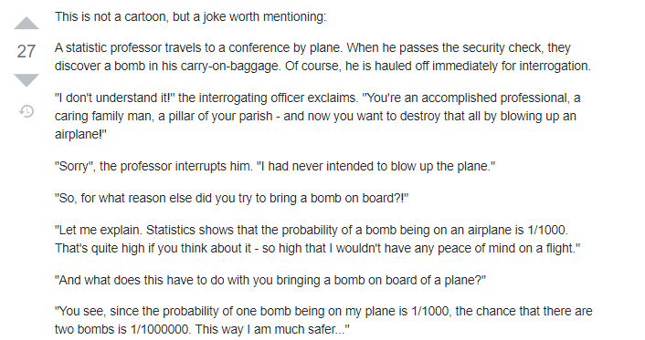

Slide 60
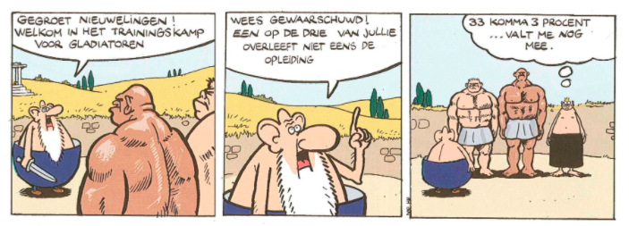
Importance of distribution or conditional probability
Notes:
Greetings new recruits! Welcome to the training camp for gladiators
Be warned! One in three of you does not survive the training
33.3% ... That's not so bad
humor - What is your favorite "data analysis" cartoon? - Cross Validated
https://stats.stackexchange.com/questions/423/what-is-your-favorite-data-analysis-cartoon/38295#38295
As a pointer to why we should think about conditional probabilities (and from then on, to why tools like logistic regression are useful for predicting risk) this is an excellent cartoon.

Slide 61
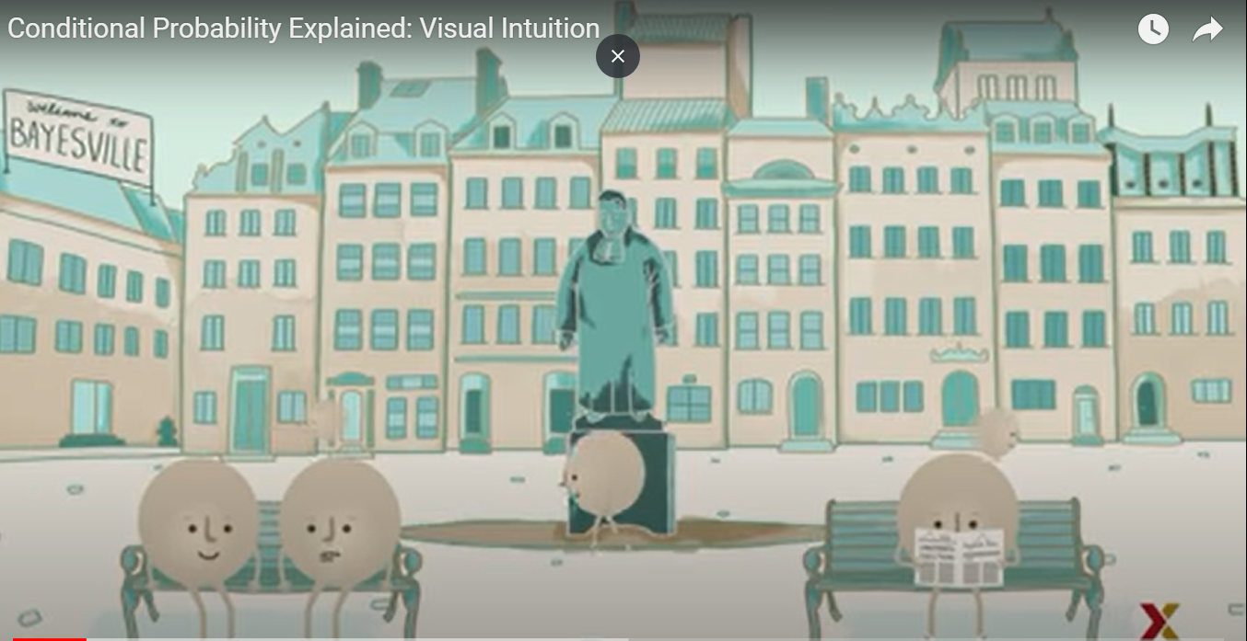

Slide 62
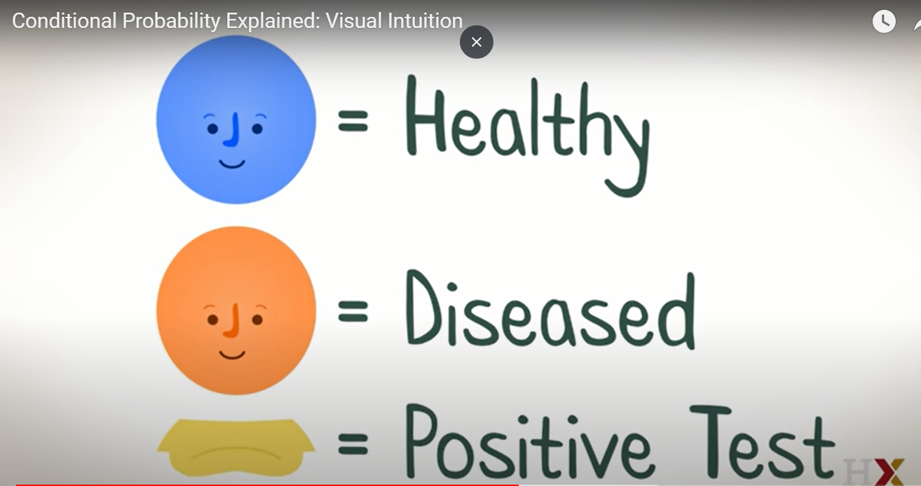

Slide 63
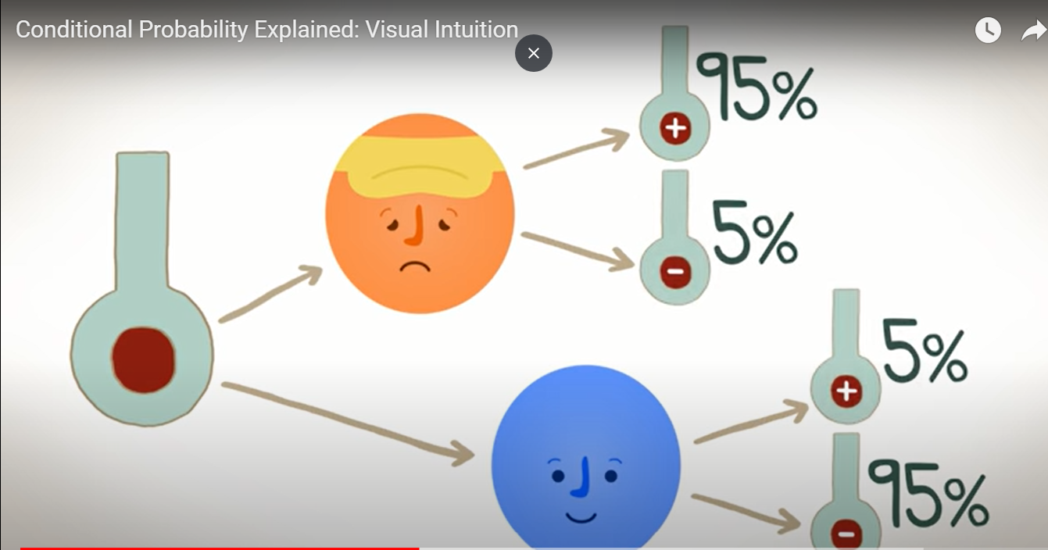

Slide 64
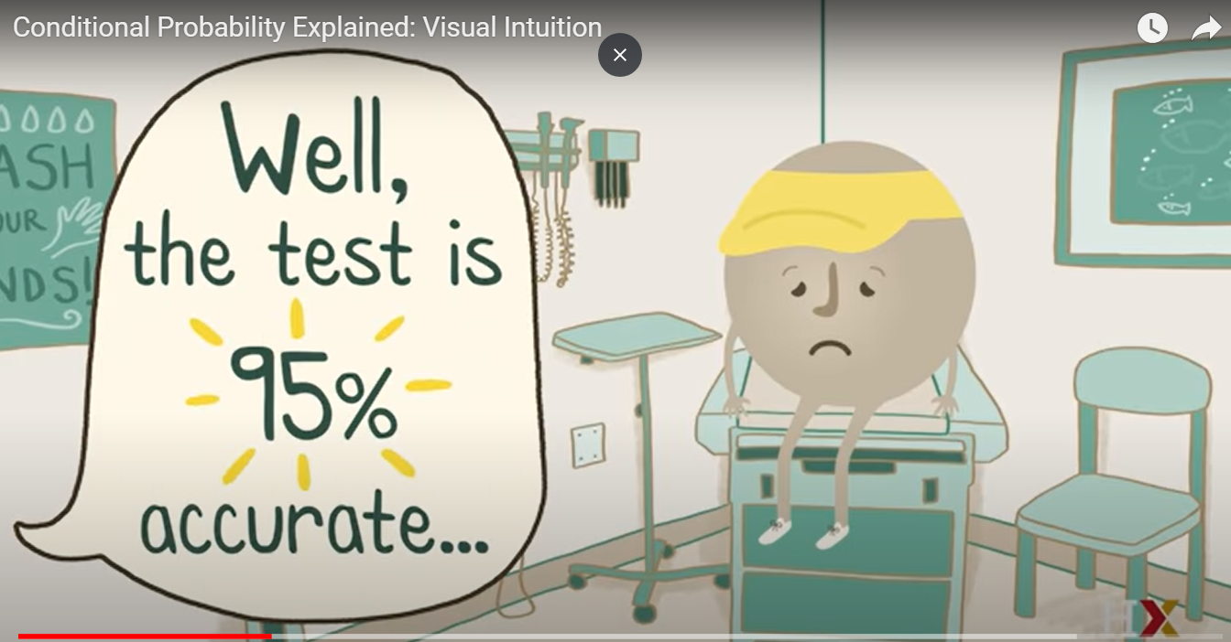

Slide 65
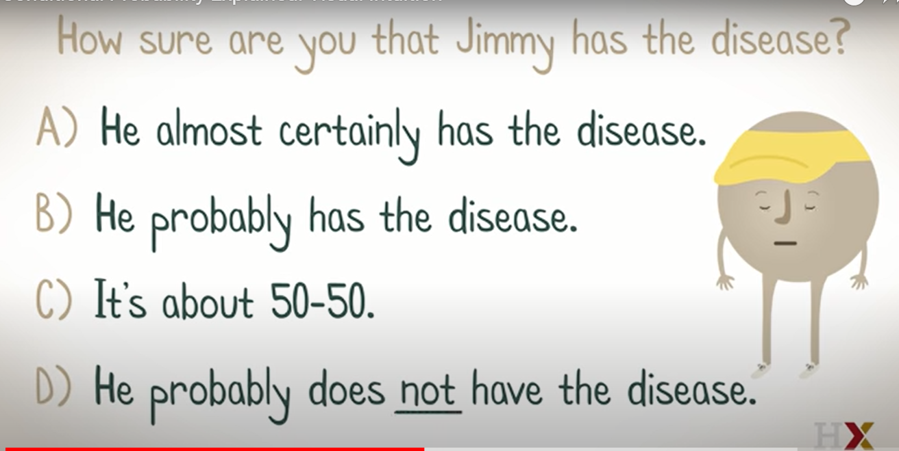
Notes:
Can’t answer!!!
We need the prevalence
True for positive predictive value

Slide 66
How common is the disease?
Prevalence
1%

Slide 67
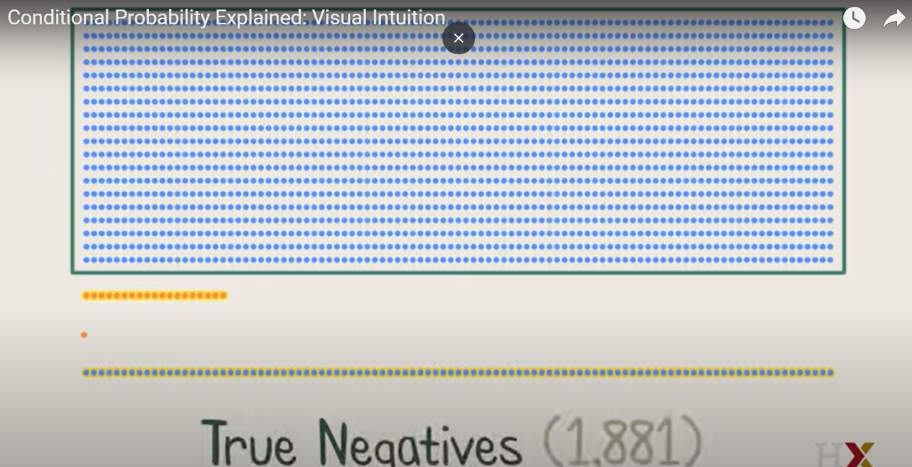
Notes:
Are they of equal importance to me?
Which one u thing is the false positive ?

Slide 68


Is this good?
Notes:
Maybe it’s not bad
Maybe we need this test to exclude, and if we have false positive, we can head to a better test with higher specificity

Slide 69


Slide 70

Notes:
Conditional Probability Explained: Visual Intuition - YouTube
https://www.youtube.com/watch?v=by3_weGwnMg

Slide 71

Heart of bayes theorem?
Notes:
Base Rate Fallacy - Biases & Heuristics | The Decision Lab
https://thedecisionlab.com/biases/base-rate-fallacy/

Slide 72

مدينة السمبلاوين
85% are blue and 15% are green.
Notes:
Example 1 - The cab problem
This classic example of the base rate fallacy is presented in Bar-Hillel’s foundational paper on the topic.¹¹ First, participants are given the following base rate information. There are two cab companies in a city: one is the “Green” company, the other is the “Blue” company. The names of the company refer to the colors of their respective taxis. It is specified that, of all the cabs in the city, 85% are blue and 15% are green.

Slide 73



Hit and run
Notes:
Then, a scenario is described in which a cab, which a witness later identifies as green, was involved in a hit and run one night.

Slide 74

Probability that hit was by green car?
witness can accurately distinguish the colors 80% of the time but confuses them 20% of the time
Notes:
In order to assess the reliability of the witness, the court ordered that their ability to discriminate between blue and green cabs at nighttime be tested. It is shown that the witness can accurately distinguish the colors 80% of the time but confuses them 20% of the time. Participants are then asked to give the likelihood that the cab involved in the hit and run was actually green.

Slide 75
Base rate neglect
85% are blue and 15% are green.
P(witness correct) = 41%.
Notes:
Many people are inclined to respond that the probability that the witness correctly identified a green cab at night is 80%. However, everyone who gives that answer is committing the base rate fallacy. When taking into account the base rate information, which tells us that only 15% of the cabs in the city are green, the actual probability that the witness was correct is 41%. This probability is achieved through inferential statistics calculations, which take into account both the percentage of each color cab in the city and the likelihood that the witness correctly discriminated between the colors at night.

Slide 76

Rule 1
Notes:
U focused on likelihood (results) that tom is shy
And forgot about prior, number of students in each major
This is very common and it is called “bayes rate neglect”

Slide 77

Notes:
What’s the probability that if he left the kitchen and took a look of the balcony that he will come back and kidnap the kids?

Slide 78


Slide 79

Should have this effect

Slide 80

Why 80:10 - why 1:100?
Notes:
Sure u can take precautions
But it totally differs if u are taken precautions because something will happen for sure
Or if u know it is still not common ( so u won’t freak out) and u still take the precautions

Slide 81

Notes:
Are people expected to know the probability of a repair’s man being a robber? No

Slide 82

The question is:
Notes:
Did u consider it?
Rationality is not about knowing facts
It’s about knowing which facts are relevant

Slide 83


How to deal with info?
Notes:
Bob is jealous from amy
The likelihood: one time amy didn’t finish a project she was assigned
Bob is complaining about amy not finishing the project

Slide 84


Slide 85

What if not jealous?
Notes:
If he wasn’t jealous, there is still a high probability that he would complain about her

Slide 86

Update rationally

Slide 87

Rule 2

Slide 88


Slide 89

What u think?

Slide 90
New data
A smart friend tells u meditation is useful
What to do?

Slide 91

Update a bit!
It depends
Notes:
Depends on ur prior.. Were u sure that meditation was fake?
Is ur friend related to meditation?
Apart from being smart? Do u trust him?

Slide 92


More and more info?

Slide 93

3 rules

Slide 94

Want more info?
Notes:
A visual guide to Bayesian thinking - YouTube
https://www.youtube.com/watch?v=BrK7X_XlGB8

Slide 95
Heart of bayes’ theorem?
???

Slide 96


Slide 97

Maybe we differ
Notes:
But how we update our beliefs is what really matter

Slide 98

Normal distribution

Slide 99
visualize
https://istats.shinyapps.io/NormalDist/

Slide 100
Real life example
View data locally (R studio)
Notes:
Zprojects/ran/starting 2020-2-15/requiredanalysisforpatientcost/new_tasks.Rmd

Slide 101
Why so important?
Statistical tests visualized (Local pdf )

Slide 102

Notes:
which_test_flowchart.png (6131×2669)
https://onishlab.colostate.edu/wp-content/uploads/2019/07/which_test_flowchart.png

Slide 103

Does it really matter?
P value parametric: 0.04
P value non par. : 0.63
Notes:
Look at mean and median for both males and female
Look how females are right skewed
GraphPad Prism 9 Statistics Guide - The Mann-Whitney test doesn't really compare medians
https://www.graphpad.com/guides/prism/latest/statistics/stat_nonparametric_tests_dont_compa.htm

Slide 104



Normality tests

Slide 105
Can we avoid this assumption?
See you next week

Slide 106
Lefthanded project
https://www.datacamp.com/projects/479

